Slide 1
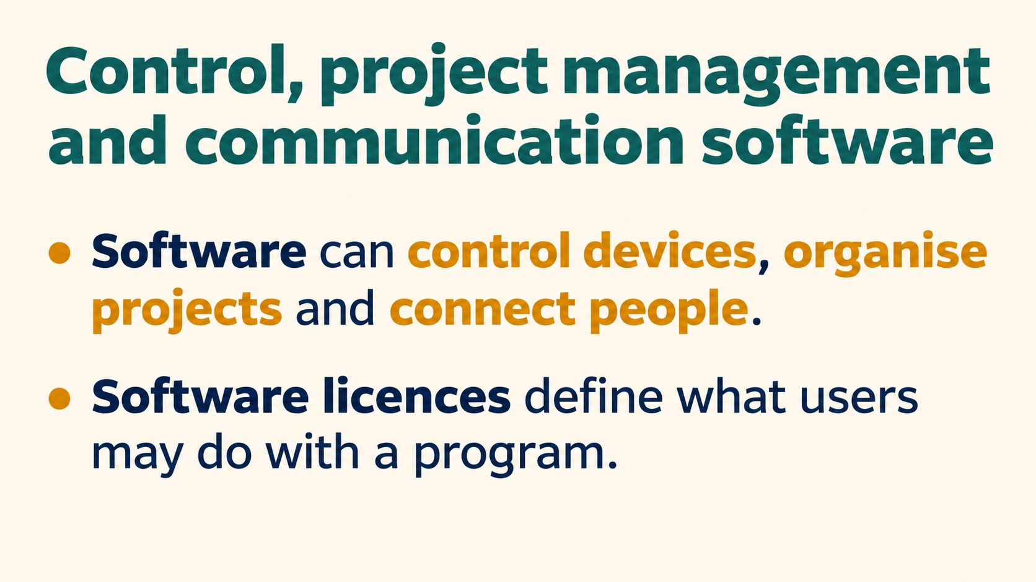
Notes:
Control, project management and communication software
Software can control devices, organise projects and connect people.
Software licences define what users may do with a program.
Source: Pearson Edexcel International GCSE (9-1) ICT, Unit 1, Chapter 2 Software, printed pages 52-57. Activities adapted for classroom discussion. Slide artwork generated with OpenAI image generation.

Slide 2
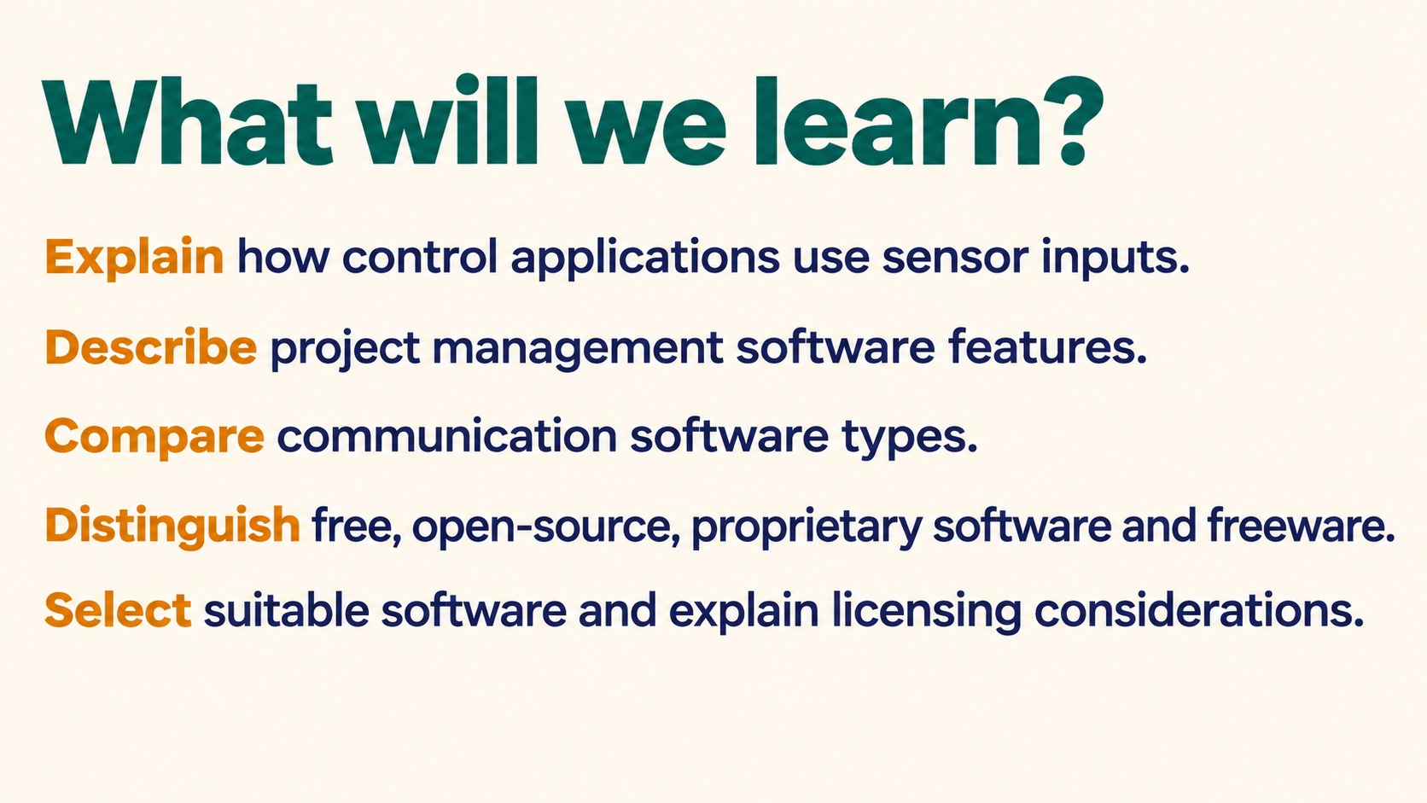
Notes:
What will we learn?
Explain how control applications use sensor inputs.
Describe project management software features.
Compare communication software types.
Distinguish free, open-source, proprietary software and freeware.
Select suitable software and explain licensing considerations.
Source: Pearson Edexcel International GCSE (9-1) ICT, Unit 1, Chapter 2 Software, printed pages 52-57. Activities adapted for classroom discussion. Slide artwork generated with OpenAI image generation.

Slide 3
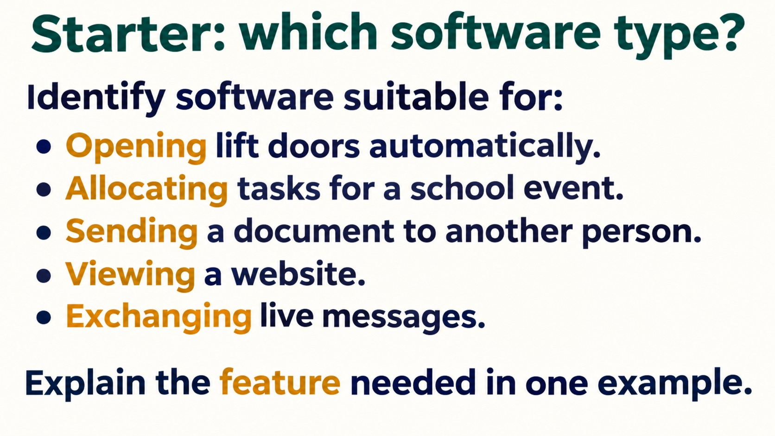
Notes:
Starter: which software type?
Identify software suitable for:
Opening lift doors automatically.
Allocating tasks for a school event.
Sending a document to another person.
Viewing a website.
Exchanging live messages.
Explain the feature needed in one example.
Answers: control; project management; email/file transfer; browser; instant messaging. Accept appropriate alternatives with justification.
Source: Pearson Edexcel International GCSE (9-1) ICT, Unit 1, Chapter 2 Software, printed pages 52-57. Activities adapted for classroom discussion. Slide artwork generated with OpenAI image generation.

Slide 4
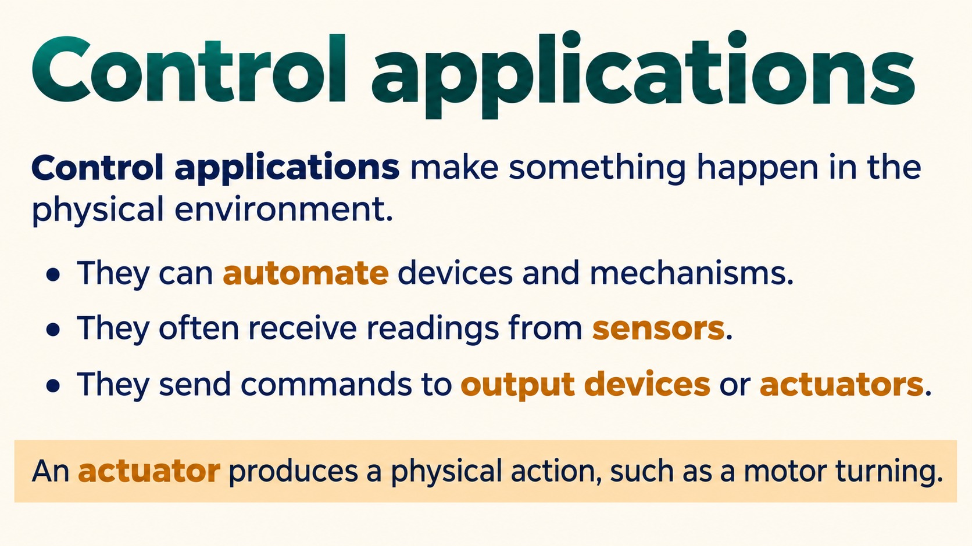
Notes:
Control applications
Control applications make something happen in the physical environment.
They can automate devices and mechanisms.
They often receive readings from sensors.
They send commands to output devices or actuators.
An actuator produces a physical action, such as a motor turning.
Source: Pearson Edexcel International GCSE (9-1) ICT, Unit 1, Chapter 2 Software, printed pages 52-57. Activities adapted for classroom discussion. Slide artwork generated with OpenAI image generation.

Slide 5
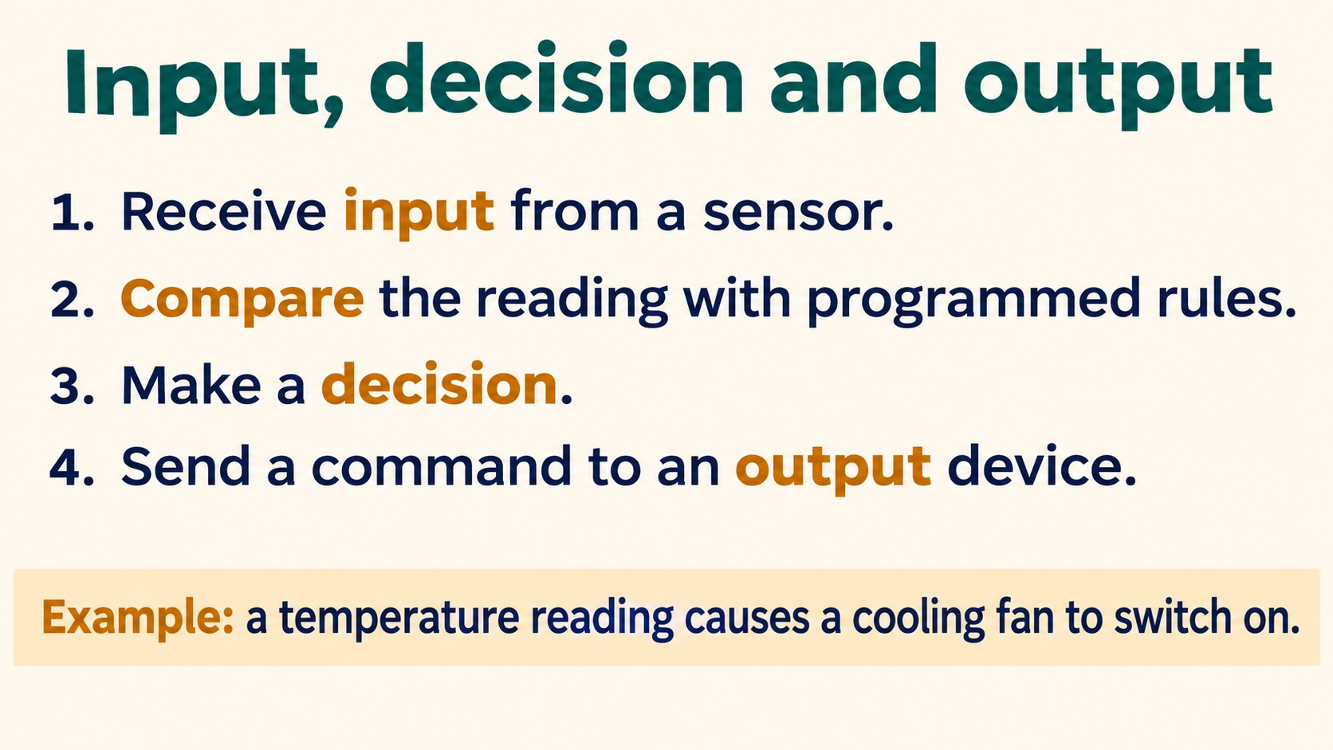
Notes:
Input, decision and output
1. Receive input from a sensor.
2. Compare the reading with programmed rules.
3. Make a decision.
4. Send a command to an output device.
Example: a temperature reading causes a cooling fan to switch on.
Identify a temperature sensor, a threshold comparison and a fan motor. A controller can continue monitoring as part of repeated operation.
Source: Pearson Edexcel International GCSE (9-1) ICT, Unit 1, Chapter 2 Software, printed pages 52-57. Activities adapted for classroom discussion. Slide artwork generated with OpenAI image generation.

Slide 6
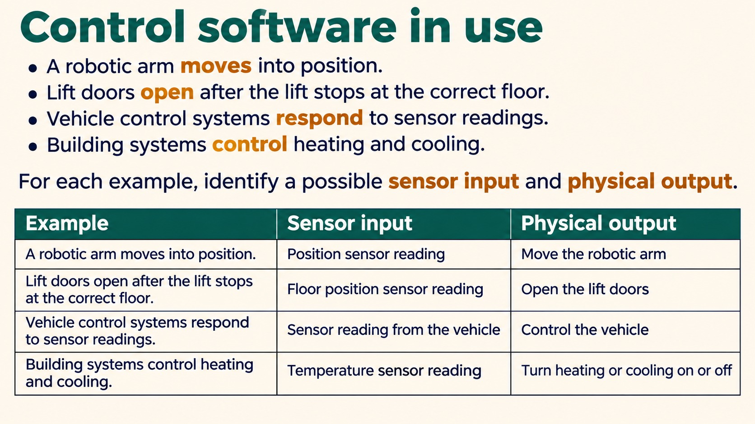
Notes:
Control software in use
A robotic arm moves into position.
Lift doors open after the lift stops at the correct floor.
Vehicle control systems respond to sensor readings.
Building systems control heating and cooling.
For each example, identify a possible sensor input and physical output.
Source: Pearson Edexcel International GCSE (9-1) ICT, Unit 1, Chapter 2 Software, printed pages 52-57. Activities adapted for classroom discussion. Slide artwork generated with OpenAI image generation.

Slide 7
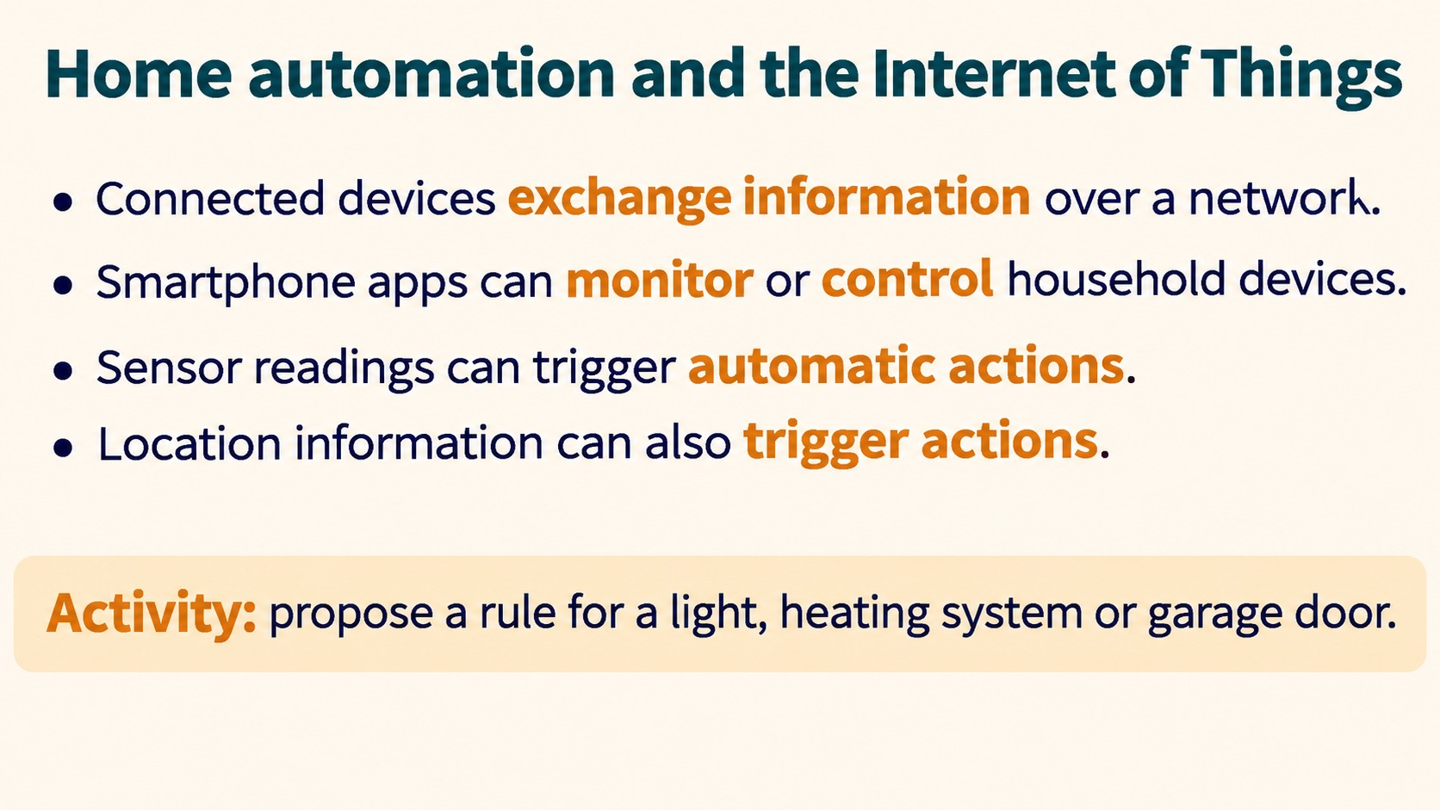
Notes:
Home automation and the Internet of Things
Connected devices exchange information over a network.
Smartphone apps can monitor or control household devices.
Sensor readings can trigger automatic actions.
Location information can also trigger actions.
Activity: propose a rule for a light, heating system or garage door.
The book discusses a smartphone location triggering a garage door. A suitable rule links an input condition with a specific output action.
Source: Pearson Edexcel International GCSE (9-1) ICT, Unit 1, Chapter 2 Software, printed pages 52-57. Activities adapted for classroom discussion. Slide artwork generated with OpenAI image generation.

Slide 8
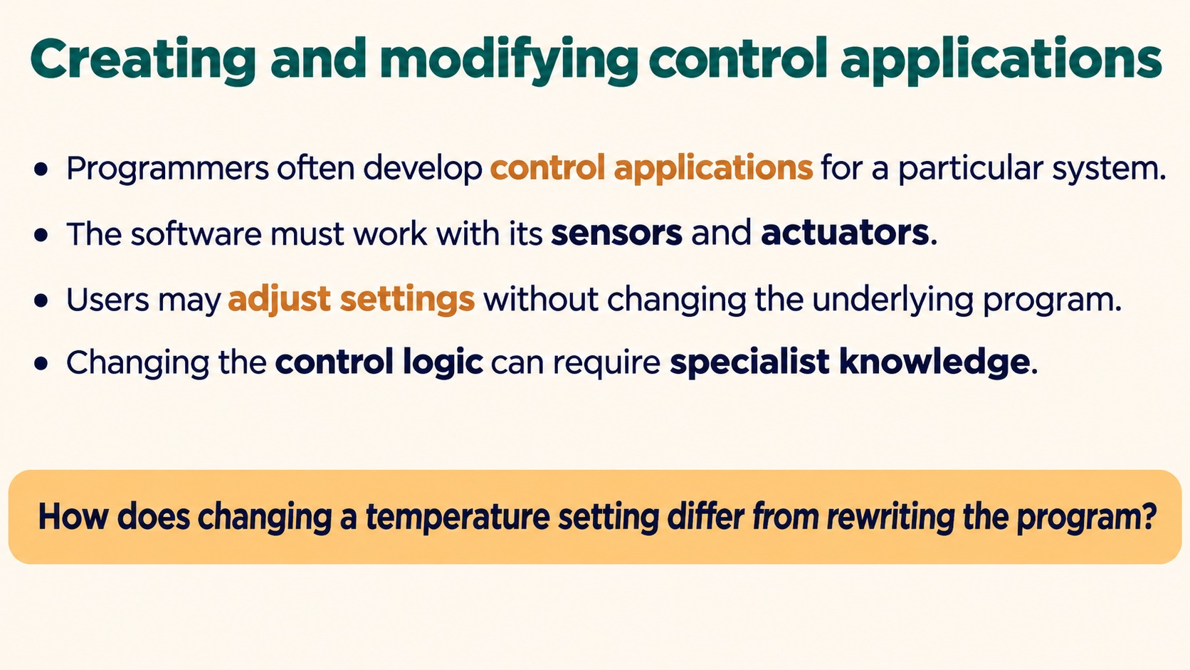
Notes:
Creating and modifying control applications
Programmers often develop control applications for a particular system.
The software must work with its sensors and actuators.
Users may adjust settings without changing the underlying program.
Changing the control logic can require specialist knowledge.
How does changing a temperature setting differ from rewriting the program?
Source: Pearson Edexcel International GCSE (9-1) ICT, Unit 1, Chapter 2 Software, printed pages 52-57. Activities adapted for classroom discussion. Slide artwork generated with OpenAI image generation.

Slide 9
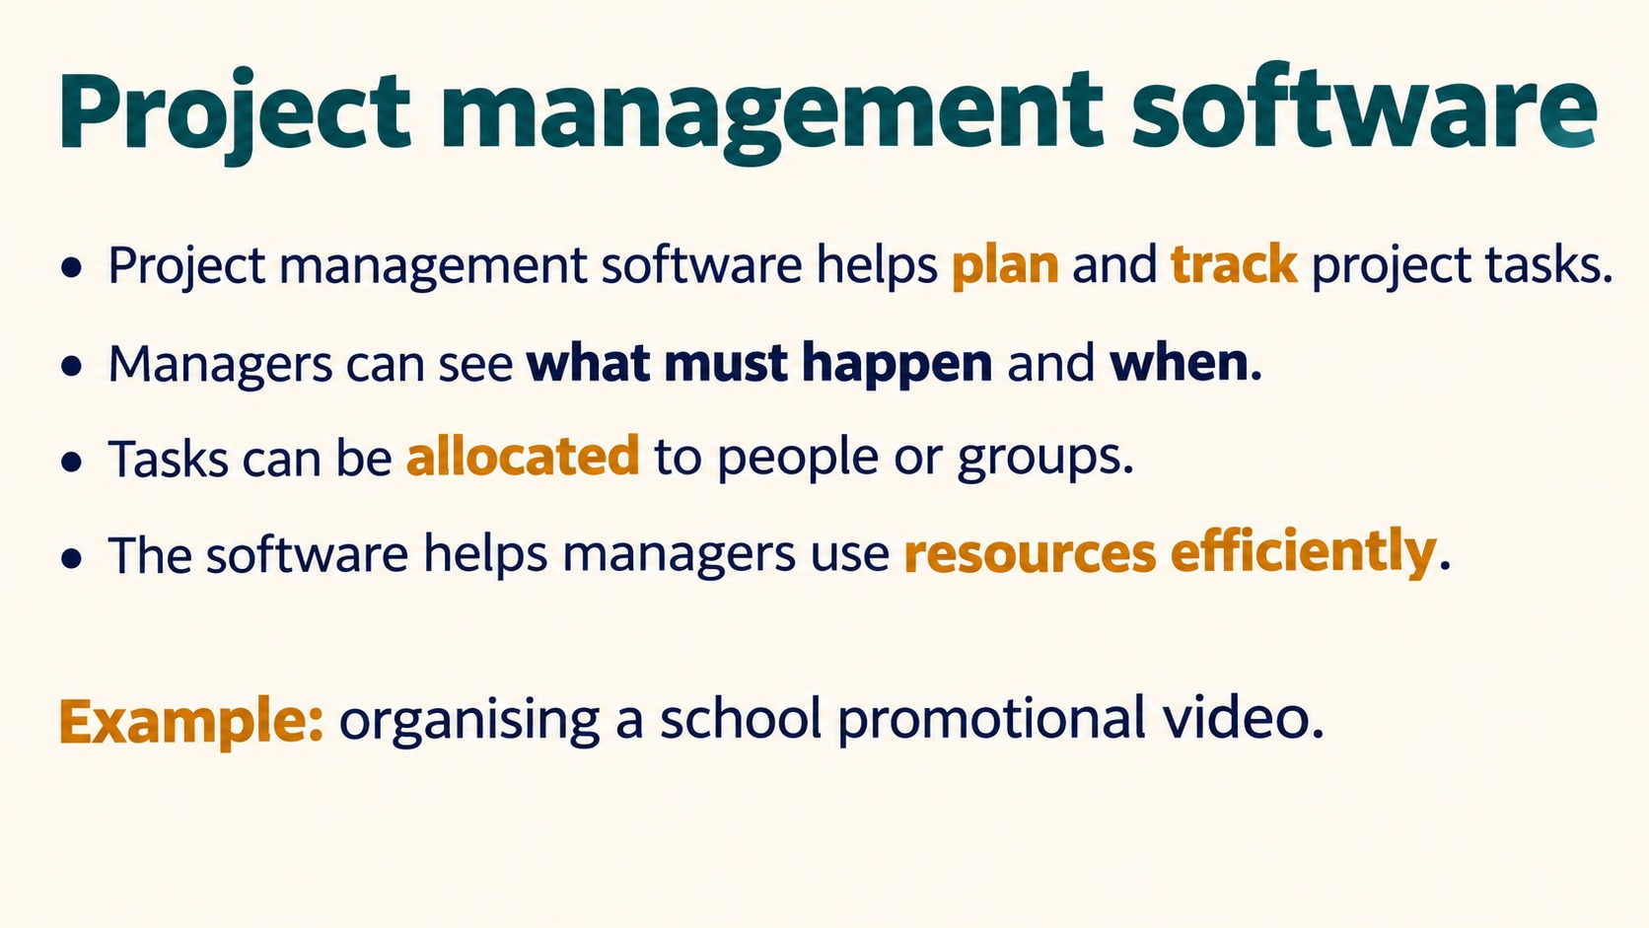
Notes:
Project management software
Project management software helps plan and track project tasks.
Managers can see what must happen and when.
Tasks can be allocated to people or groups.
The software helps managers use resources efficiently.
Example: organising a school promotional video.
Source: Pearson Edexcel International GCSE (9-1) ICT, Unit 1, Chapter 2 Software, printed pages 52-57. Activities adapted for classroom discussion. Slide artwork generated with OpenAI image generation.

Slide 10
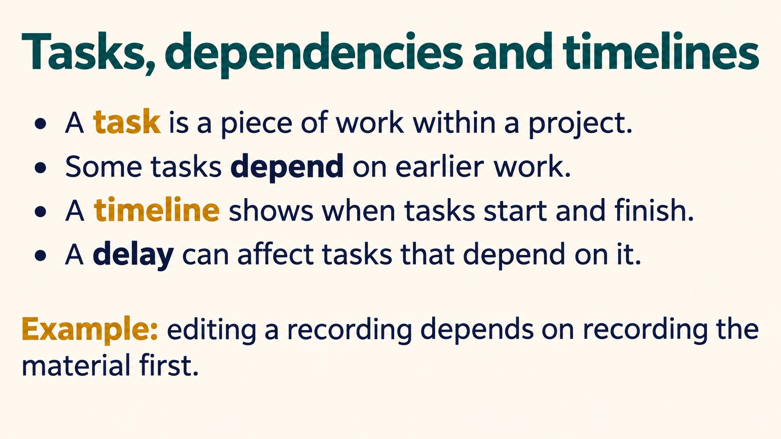
Notes:
Tasks, dependencies and timelines
A task is a piece of work within a project.
Some tasks depend on earlier work.
A timeline shows when tasks start and finish.
A delay can affect tasks that depend on it.
Example: editing a recording depends on recording the material first.
Source: Pearson Edexcel International GCSE (9-1) ICT, Unit 1, Chapter 2 Software, printed pages 52-57. Activities adapted for classroom discussion. Slide artwork generated with OpenAI image generation.

Slide 11
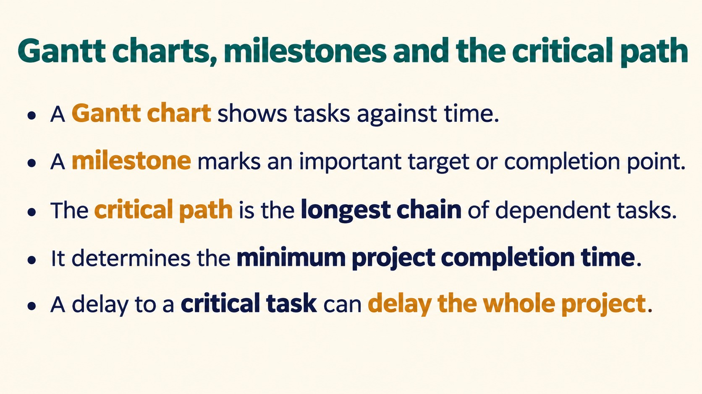
Notes:
Gantt charts, milestones and the critical path
A Gantt chart shows tasks against time.
A milestone marks an important target or completion point.
The critical path is the longest chain of dependent tasks.
It determines the minimum project completion time.
A delay to a critical task can delay the whole project.
Source: Pearson Edexcel International GCSE (9-1) ICT, Unit 1, Chapter 2 Software, printed pages 52-57. Activities adapted for classroom discussion. Slide artwork generated with OpenAI image generation.

Slide 12
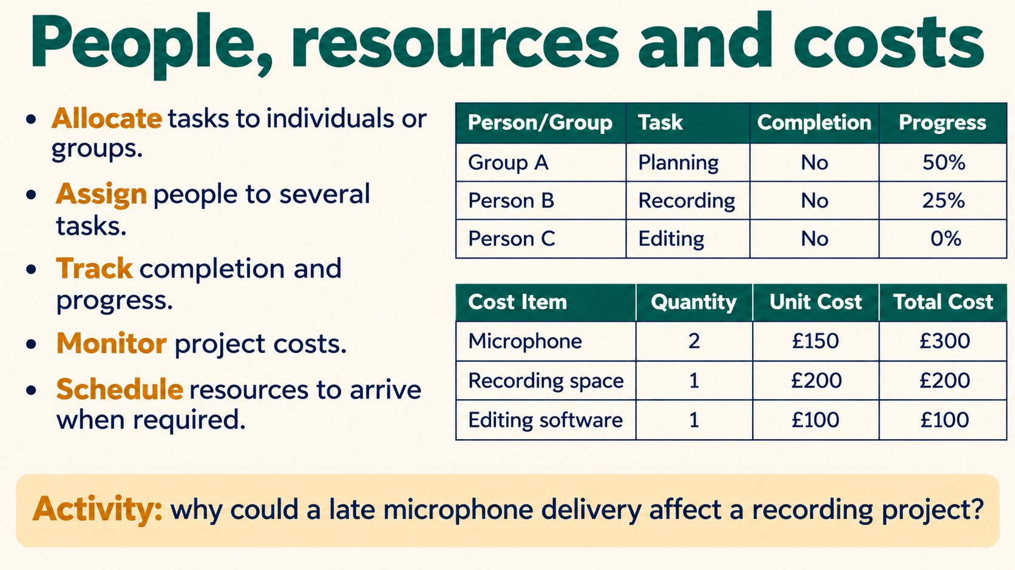
Notes:
People, resources and costs
Allocate tasks to individuals or groups.
Assign people to several tasks.
Track completion and progress.
Monitor project costs.
Schedule resources to arrive when required.
Activity: why could a late microphone delivery affect a recording project?
Source: Pearson Edexcel International GCSE (9-1) ICT, Unit 1, Chapter 2 Software, printed pages 52-57. Activities adapted for classroom discussion. Slide artwork generated with OpenAI image generation.

Slide 13
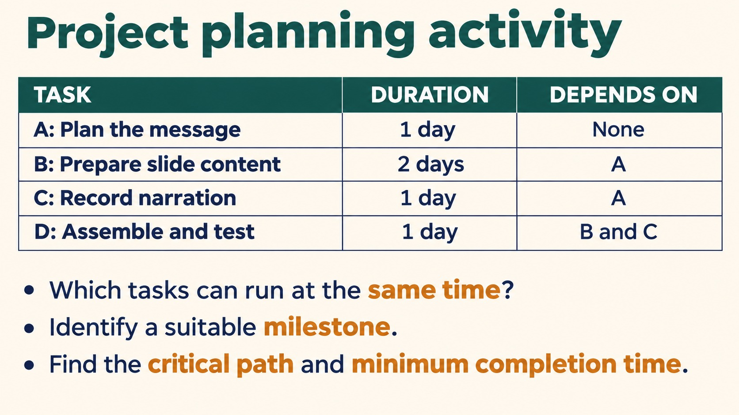
Notes:
Project planning activity
TASK DURATION DEPENDS ON
A: Plan the message 1 day None
B: Prepare slide content 2 days A
C: Record narration 1 day A
D: Assemble and test 1 day B and C
Which tasks can run at the same time?
Identify a suitable milestone.
Find the critical path and minimum completion time.
Assume resources permit B and C to run concurrently. Answer: B and C overlap; A-B-D is the critical path; minimum 4 days. An example milestone is content and narration ready for assembly.
Source: Pearson Edexcel International GCSE (9-1) ICT, Unit 1, Chapter 2 Software, printed pages 52-57. Activities adapted for classroom discussion. Slide artwork generated with OpenAI image generation.

Slide 14
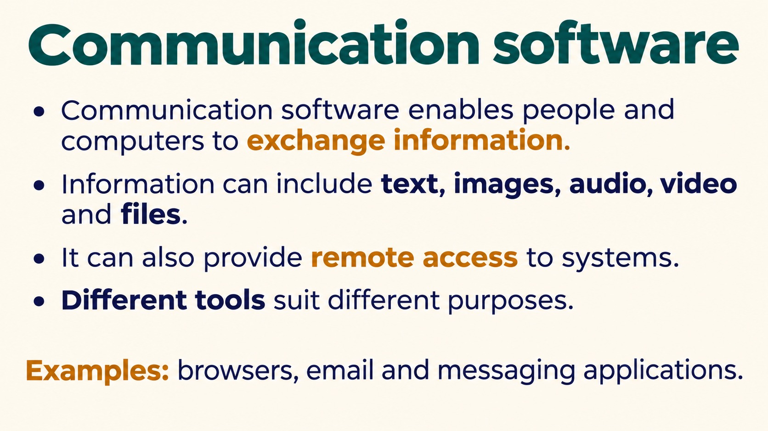
Notes:
Communication software
Communication software enables people and computers to exchange information.
Information can include text, images, audio, video and files.
It can also provide remote access to systems.
Different tools suit different purposes.
Examples: browsers, email and messaging applications.
Source: Pearson Edexcel International GCSE (9-1) ICT, Unit 1, Chapter 2 Software, printed pages 52-57. Activities adapted for classroom discussion. Slide artwork generated with OpenAI image generation.

Slide 15
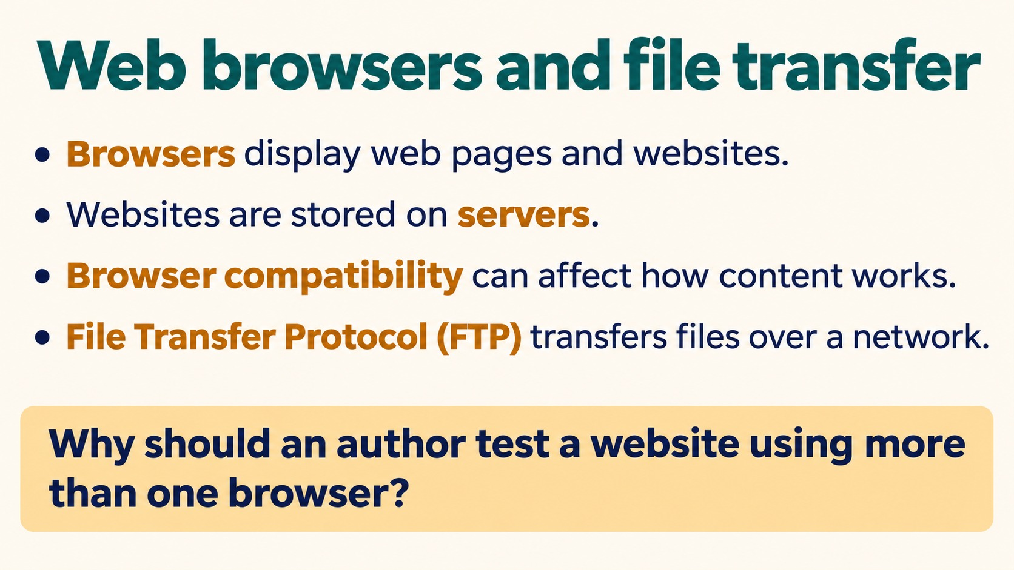
Notes:
Web browsers and file transfer
Browsers display web pages and websites.
Websites are stored on servers.
Browser compatibility can affect how content works.
File Transfer Protocol (FTP) transfers files over a network.
Why should an author test a website using more than one browser?
Different browser rendering and feature support may affect users. The book mentions browser access to FTP, but this deck describes FTP separately to avoid implying current browsers necessarily support it.
Source: Pearson Edexcel International GCSE (9-1) ICT, Unit 1, Chapter 2 Software, printed pages 52-57. Activities adapted for classroom discussion. Slide artwork generated with OpenAI image generation.

Slide 16
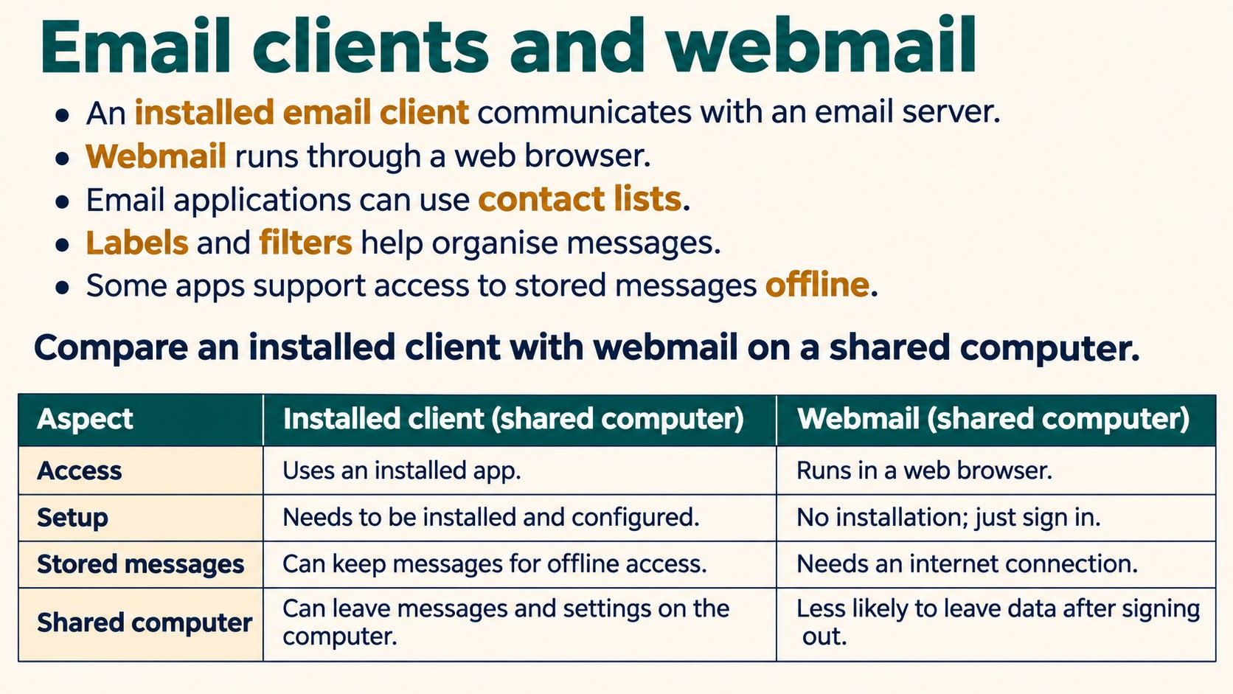
Notes:
Email clients and webmail
An installed email client communicates with an email server.
Webmail runs through a web browser.
Email applications can use contact lists.
Labels and filters help organise messages.
Some apps support access to stored messages offline.
Compare an installed client with webmail on a shared computer.
Source: Pearson Edexcel International GCSE (9-1) ICT, Unit 1, Chapter 2 Software, printed pages 52-57. Activities adapted for classroom discussion. Slide artwork generated with OpenAI image generation.

Slide 17
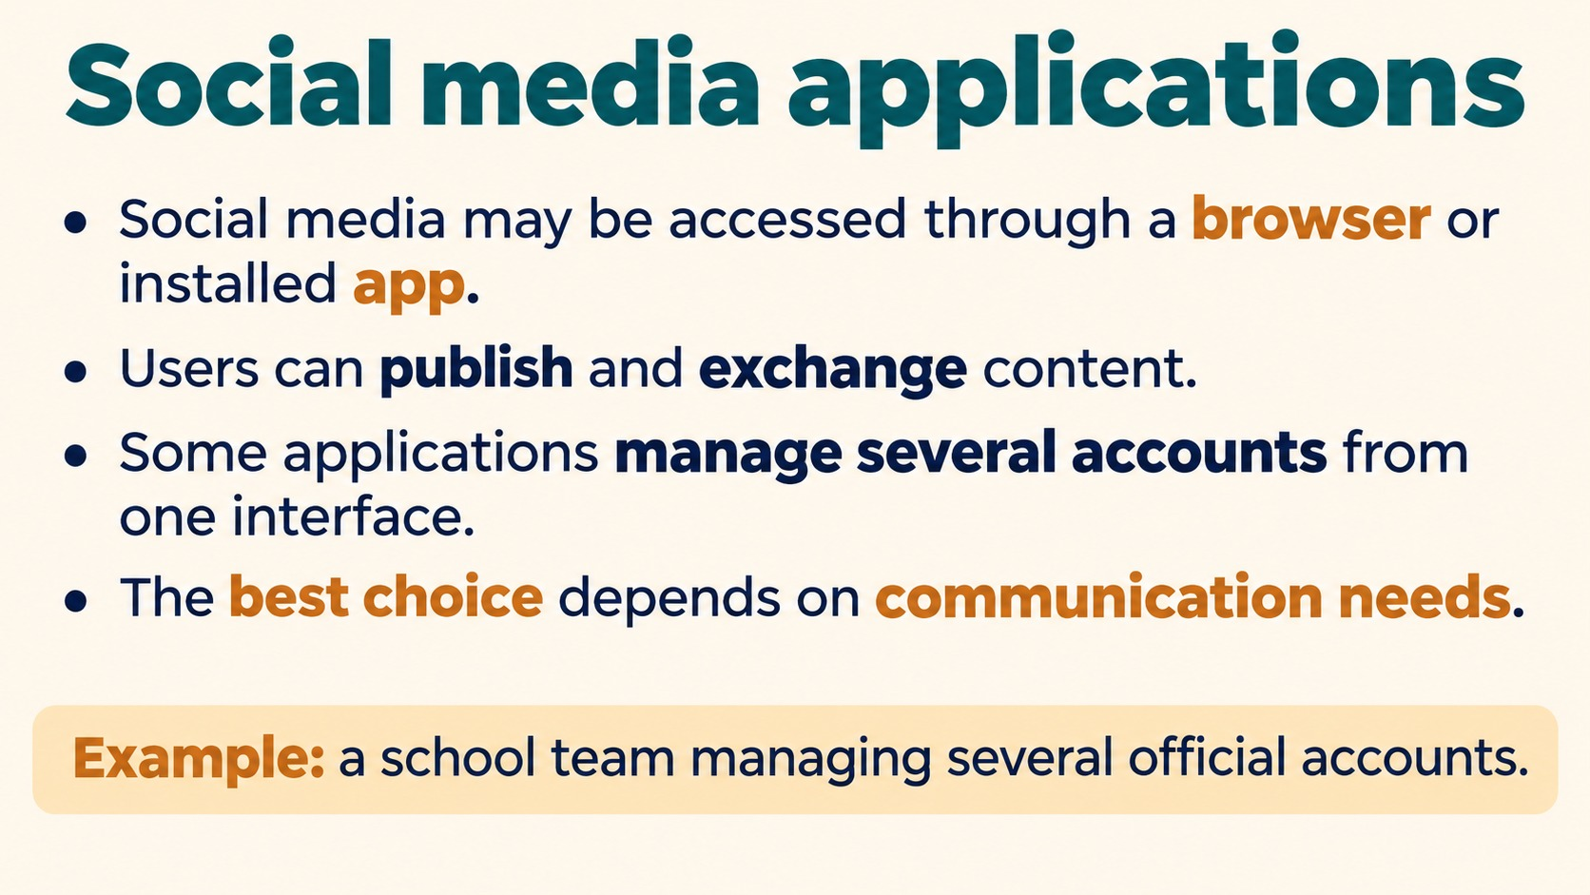
Notes:
Social media applications
Social media may be accessed through a browser or installed app.
Users can publish and exchange content.
Some applications manage several accounts from one interface.
The best choice depends on communication needs.
Example: a school team managing several official accounts.
Source: Pearson Edexcel International GCSE (9-1) ICT, Unit 1, Chapter 2 Software, printed pages 52-57. Activities adapted for classroom discussion. Slide artwork generated with OpenAI image generation.

Slide 18
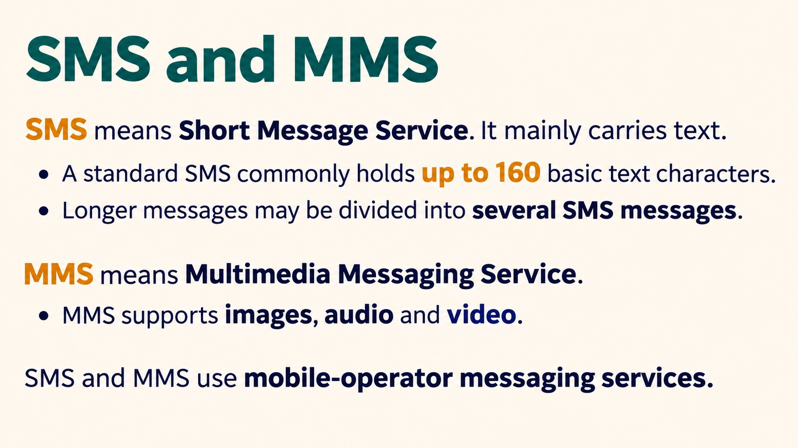
Notes:
SMS and MMS
SMS means Short Message Service. It mainly carries text.
A standard SMS commonly holds up to 160 basic text characters.
Longer messages may be divided into several SMS messages.
MMS means Multimedia Messaging Service.
MMS supports images, audio and video.
SMS and MMS use mobile-operator messaging services.
The 160-character limit depends on encoding. Keep the qualified wording basic text characters. Do not imply every Unicode message permits 160 characters.
Source: Pearson Edexcel International GCSE (9-1) ICT, Unit 1, Chapter 2 Software, printed pages 52-57. Activities adapted for classroom discussion. Slide artwork generated with OpenAI image generation.

Slide 19
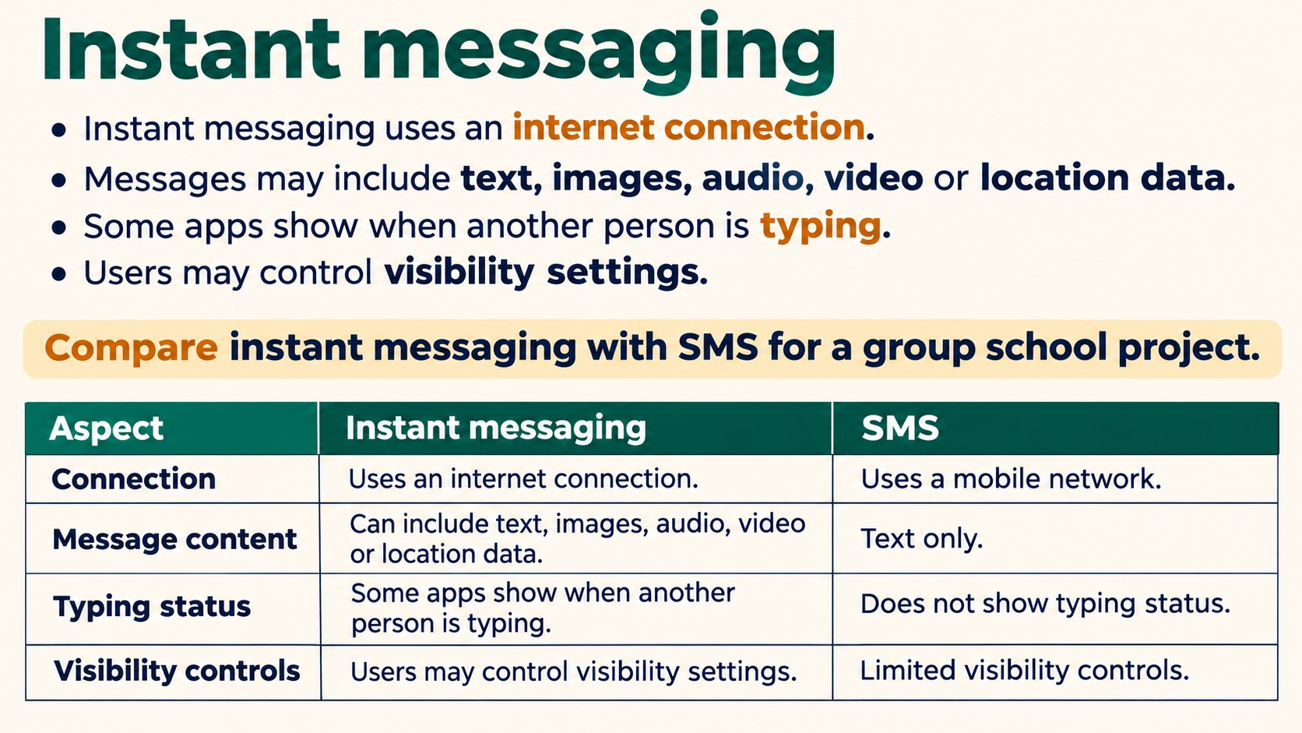
Notes:
Instant messaging
Instant messaging uses an internet connection.
Messages may include text, images, audio, video or location data.
Some apps show when another person is typing.
Users may control visibility settings.
Compare instant messaging with SMS for a group school project.
Source: Pearson Edexcel International GCSE (9-1) ICT, Unit 1, Chapter 2 Software, printed pages 52-57. Activities adapted for classroom discussion. Slide artwork generated with OpenAI image generation.

Slide 20
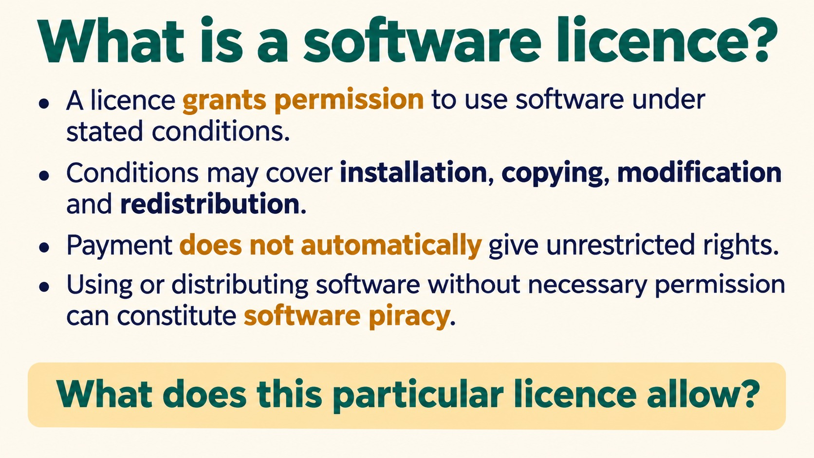
Notes:
What is a software licence?
A licence grants permission to use software under stated conditions.
Conditions may cover installation, copying, modification and redistribution.
Payment does not automatically give unrestricted rights.
Using or distributing software without necessary permission can constitute software piracy.
What does this particular licence allow?
Source: Pearson Edexcel International GCSE (9-1) ICT, Unit 1, Chapter 2 Software, printed pages 52-57. Activities adapted for classroom discussion. Slide artwork generated with OpenAI image generation.

Slide 21
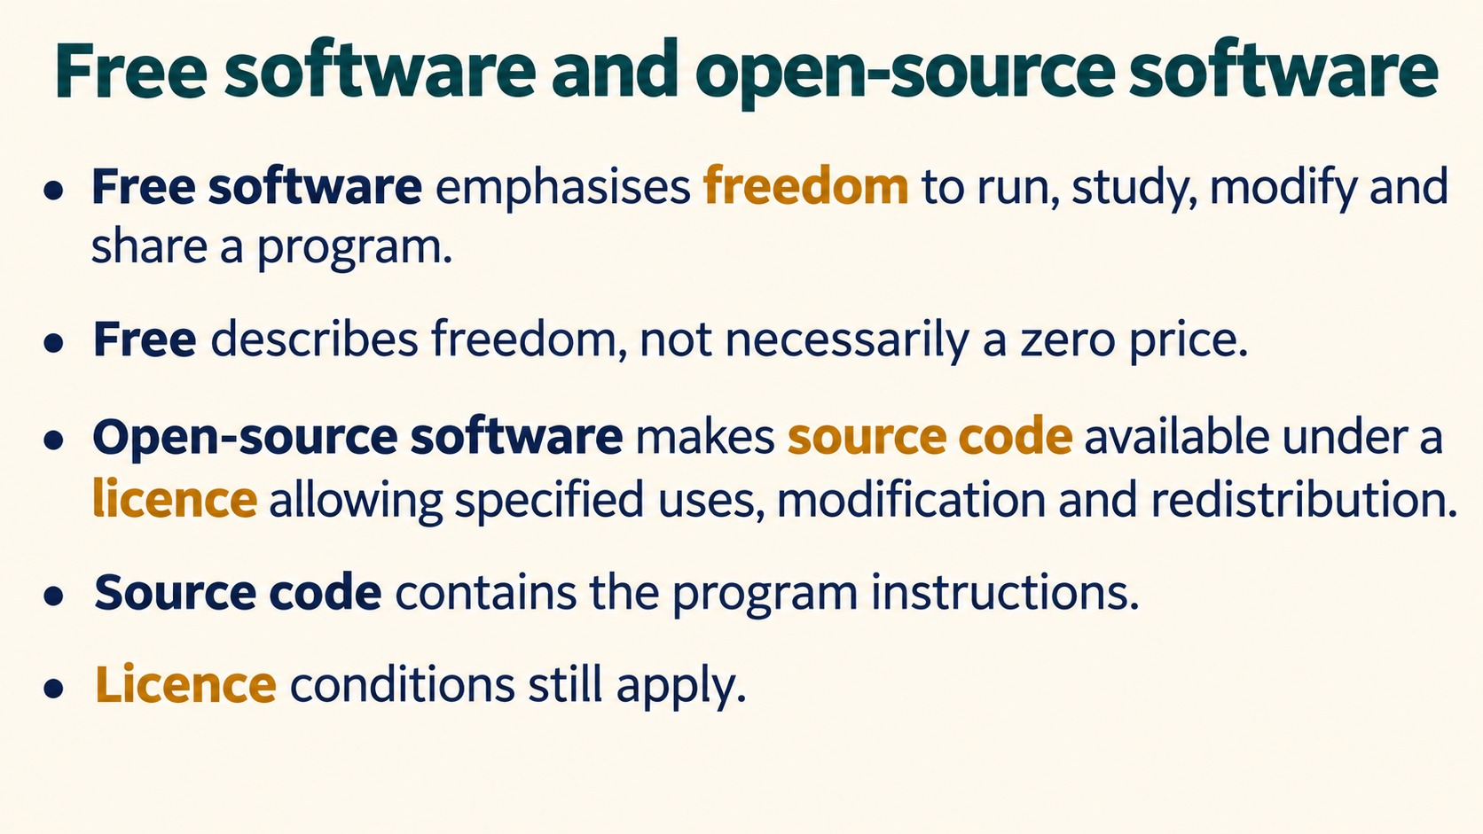
Notes:
Free software and open-source software
Free software emphasises freedom to run, study, modify and share a program.
Free describes freedom, not necessarily a zero price.
Open-source software makes source code available under a licence allowing specified uses, modification and redistribution.
Source code contains the program instructions.
Licence conditions still apply.
Source: Pearson Edexcel International GCSE (9-1) ICT, Unit 1, Chapter 2 Software, printed pages 52-57. Activities adapted for classroom discussion. Slide artwork generated with OpenAI image generation.

Slide 22
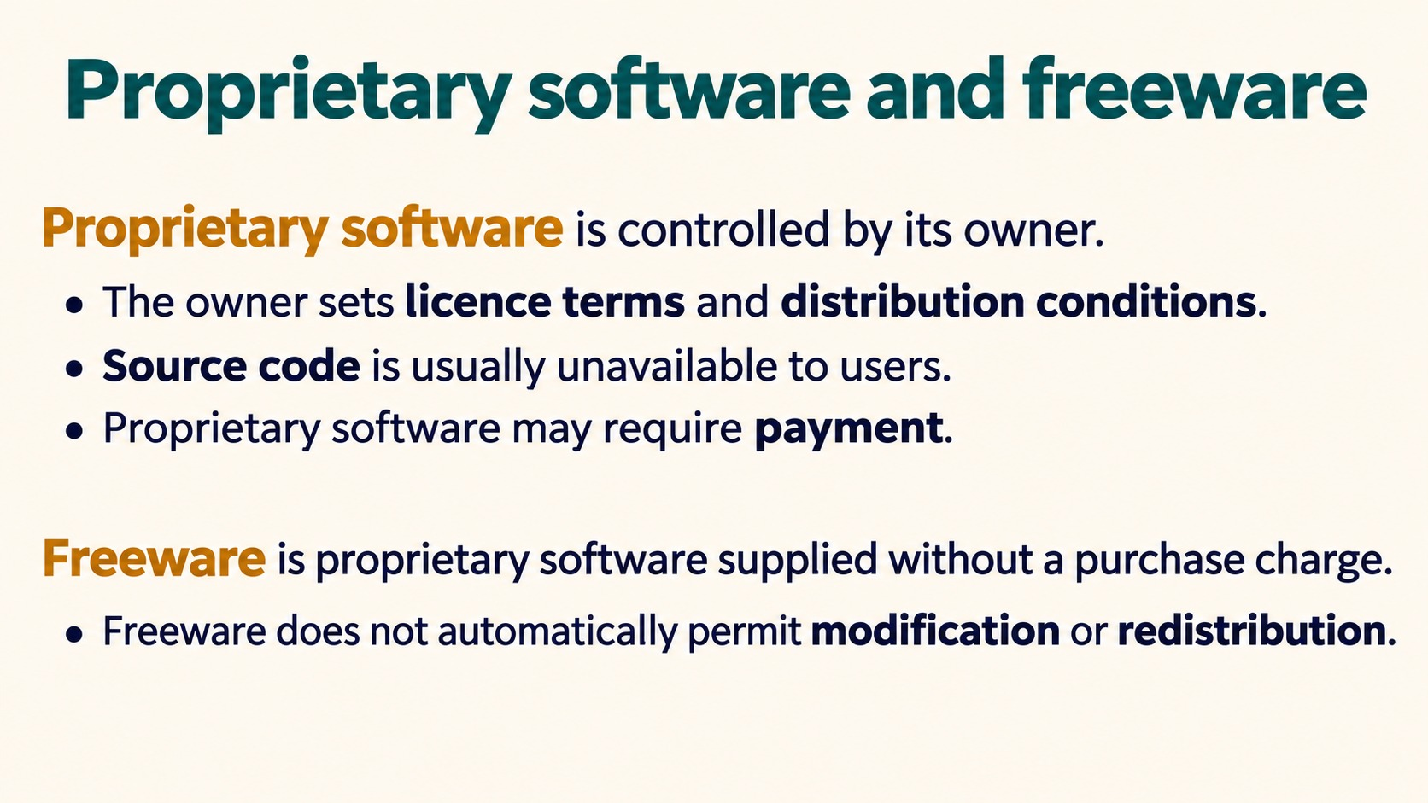
Notes:
Proprietary software and freeware
Proprietary software is controlled by its owner.
The owner sets licence terms and distribution conditions.
Source code is usually unavailable to users.
Proprietary software may require payment.
Freeware is proprietary software supplied without a purchase charge.
Freeware does not automatically permit modification or redistribution.
Source: Pearson Edexcel International GCSE (9-1) ICT, Unit 1, Chapter 2 Software, printed pages 52-57. Activities adapted for classroom discussion. Slide artwork generated with OpenAI image generation.

Slide 23
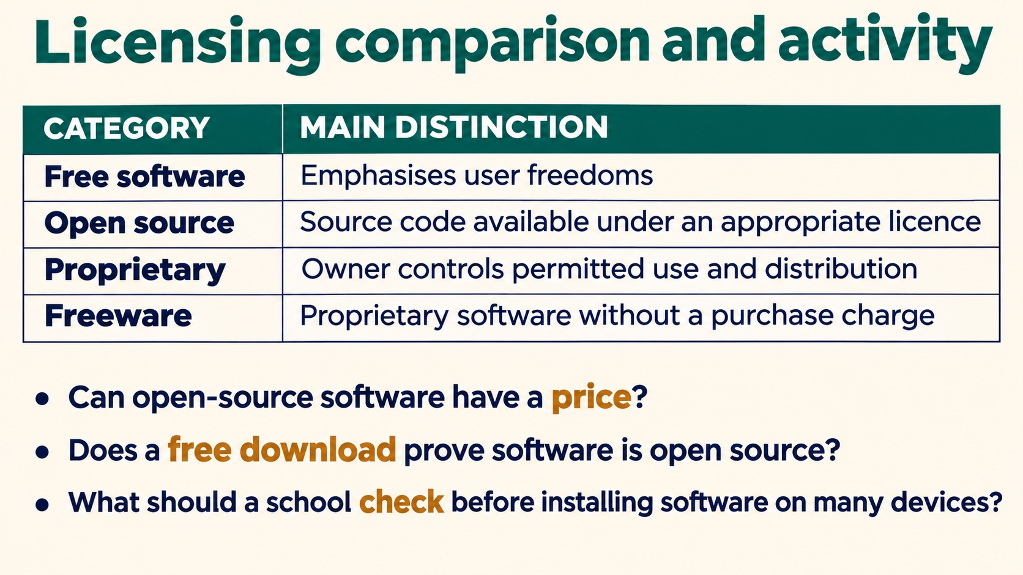
Notes:
Licensing comparison and activity
CATEGORY MAIN DISTINCTION
Free software Emphasises user freedoms
Open source Source code available under an appropriate licence
Proprietary Owner controls permitted use and distribution
Freeware Proprietary software without a purchase charge
Can open-source software have a price?
Does a free download prove software is open source?
What should a school check before installing software on many devices?
Answers: yes; no; check licence terms including permitted installations, users and redistribution. Free and open-source categories overlap rather than being mutually exclusive.
Source: Pearson Edexcel International GCSE (9-1) ICT, Unit 1, Chapter 2 Software, printed pages 52-57. Activities adapted for classroom discussion. Slide artwork generated with OpenAI image generation.

Slide 24
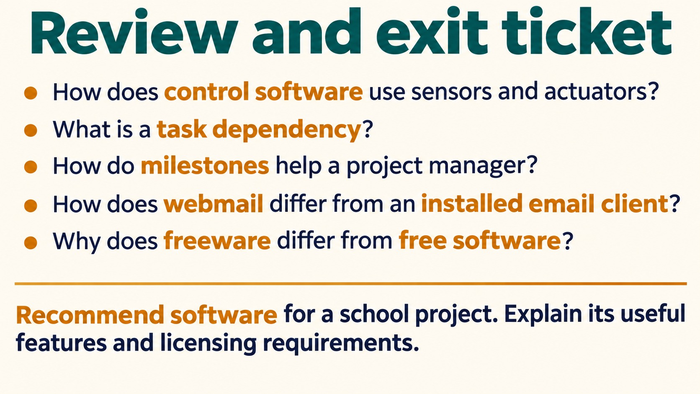
Notes:
Review and exit ticket
How does control software use sensors and actuators?
What is a task dependency?
How do milestones help a project manager?
How does webmail differ from an installed email client?
Why does freeware differ from free software?
Recommend software for a school project. Explain its useful features and licensing requirements.
For exam answers, use software type names and relevant features rather than only brand names.
Source: Pearson Edexcel International GCSE (9-1) ICT, Unit 1, Chapter 2 Software, printed pages 52-57. Activities adapted for classroom discussion. Slide artwork generated with OpenAI image generation.

